Slide 1

Exploratory Data Analysis
G2M Insights for Cab Investment Firm
Name: Deepthika Shiwani Muralikrishnan
Location: Chennai, India
Batch : LISUM01
Date: 26-June-2021

Slide 2

Agenda
Background
Data Exploration and Approach
EDA and Summary
Hypothesis Testing
Recommendations

Slide 3
Background
XYZ is a private firm in US and due to remarkable growth in the cab industry in last few years and multiple key players in the market, it is planning for an investment in cab industry.
Objective:
Summarize your analysis and recommendations and identify which company is performing better and is a better investment opportunity for XYZ.
Data Available:
Multiple datasets for two companies have been provided.
Each data set provides different aspects of the customer’s profile:
Cab Data: Includes details of transaction for the two cab companies.
Transaction ID: Mapping table that contains transaction to customer mapping and payment mode.
Customer ID: Mapping table that contains a unique identifier which links the customer’s demographic details.
City: Contains list of US cities, their population and number of cab users.

Slide 4

Data Exploration and Approach
Dataset
4 datasets with 19 unique features (5 derived).
Time period for data: 31/01/2016 to 31/12/2018.
Total data points: 359,393.
Approach
The datasets were all combined to create one master dataset.
5 features were derived from the datasets available:
Month and Year: these were derived from the date_of_travel feature.
Profit: this is the difference between price charged and cost_of_trip features
Age_range: the ages of the customers were allocated to different bins.
Percentage_users: this is a ratio in percentile of the users in each city to the population of that city.
Exploratory Data Analysis approach utilized to draw insights from the data.
This refers to the critical process of performing initial investigations on data so as to discover patterns, spot anomalies, test hypothesis and check assumptions with the help of summary statistics and graphical representations.
Cab_Data
Customer_ID
Transaction_ID
City
Dataset

Slide 5
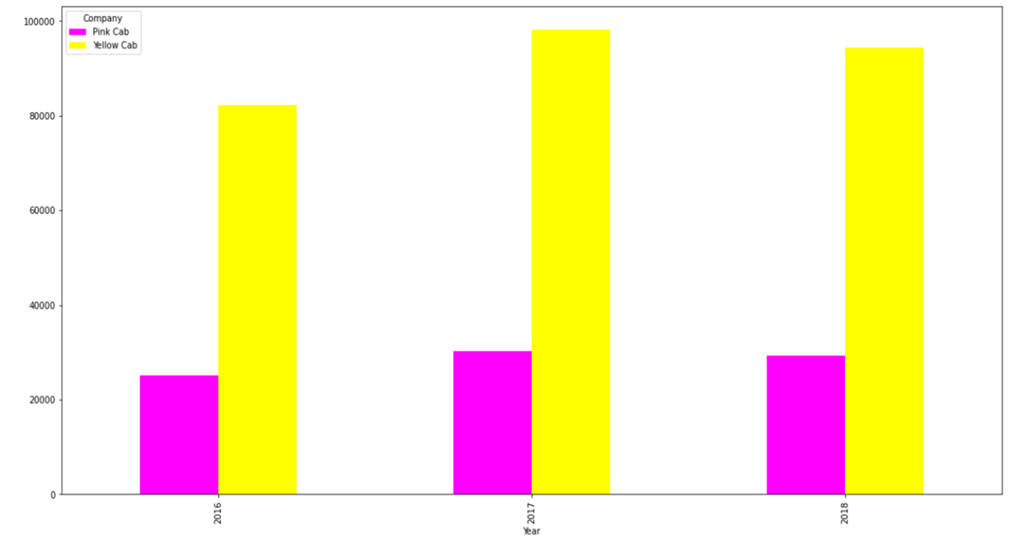
EDA and Summary – Yearly Profits Analysis
Yellow Cab seems to dominate the market with the most transactions on a yearly basis compared to Pink Cab.

Slide 6
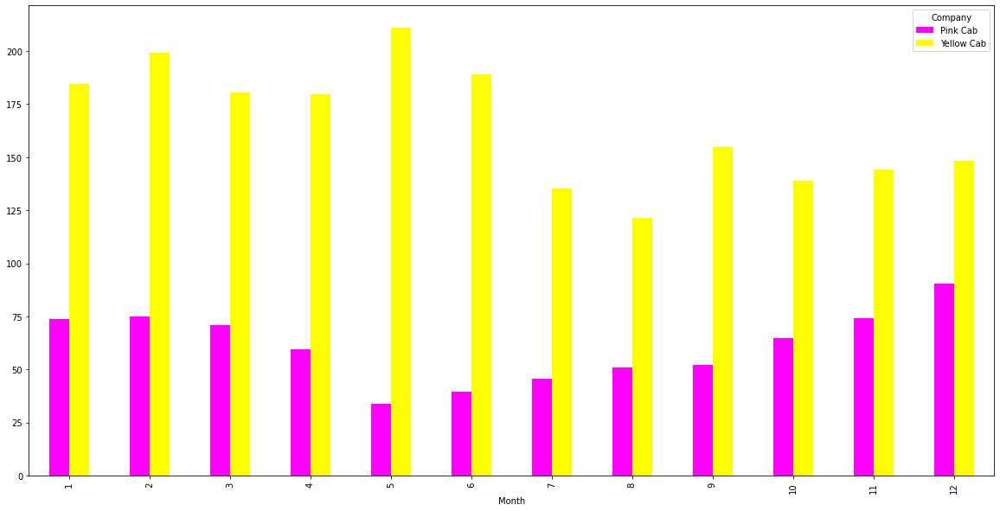
EDA and Summary – Monthly Profits Analysis
Yellow Cab seems to dominate the market with the most transactions on a montly basis compared to Pink Cab.

Slide 7
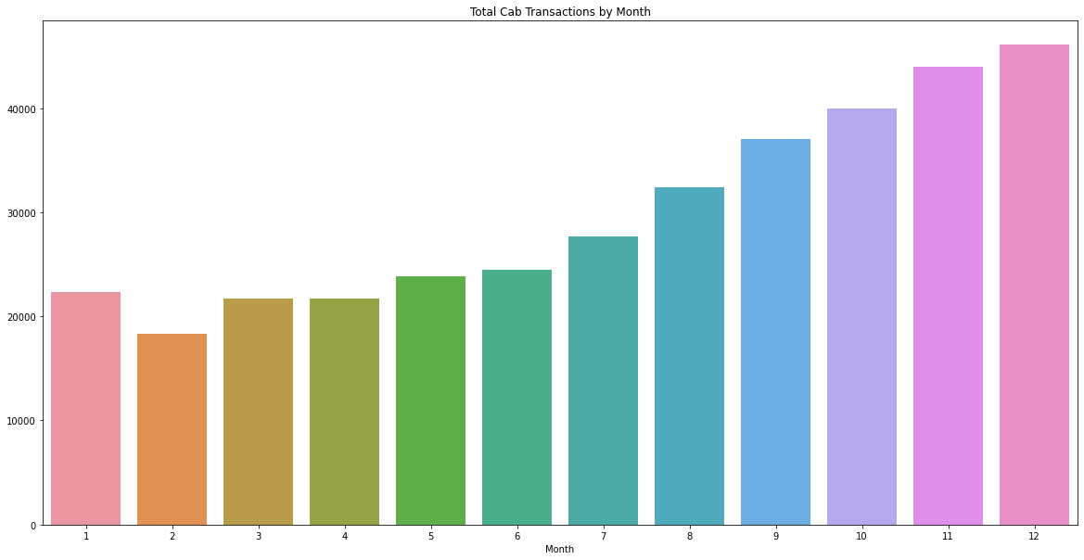
EDA and Summary – Total Cab Transactions by Month Analysis

Slide 8
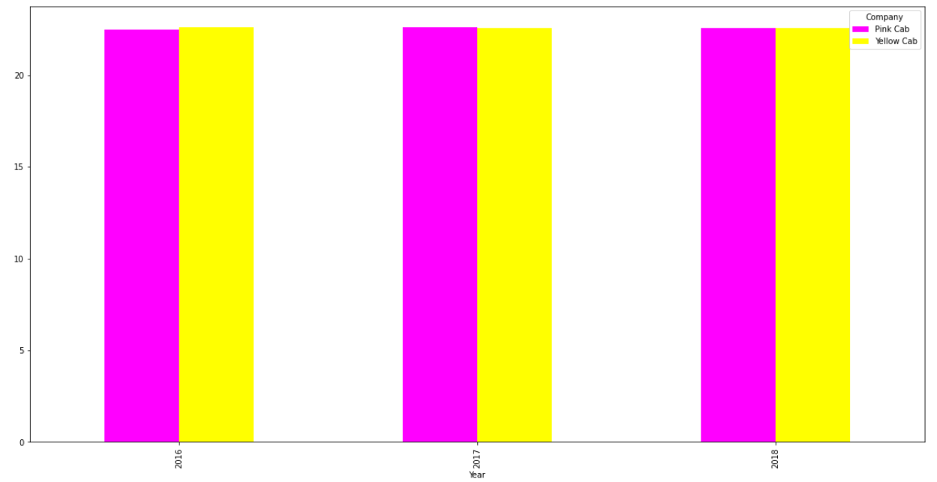
EDA and Summary – KM Travelled vs Year
There is an equal distribution of mean KM Travelled for both cab companies.

Slide 9
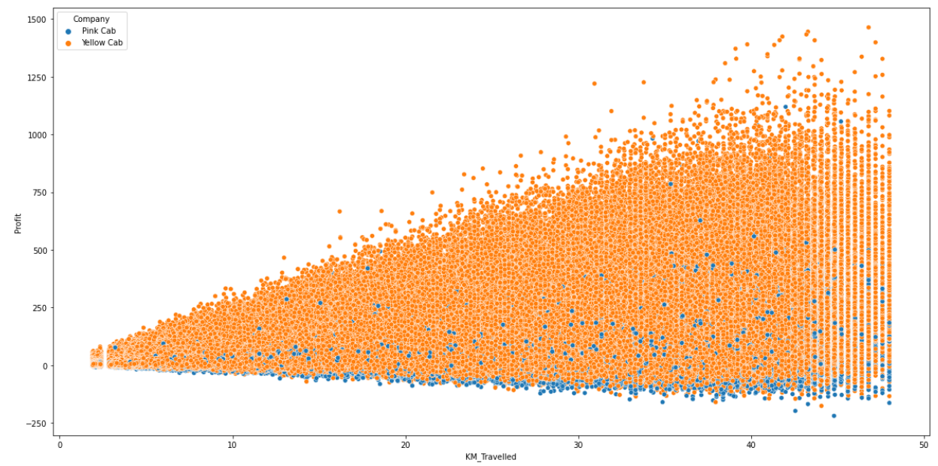
EDA and Summary – Company Profit and KM Travelled Scatterplot
The more the KM Travelled the higher the profits get.
Yellow Cab shows the most profits, with a few outlying Pink Cab profits emerging.

Slide 10
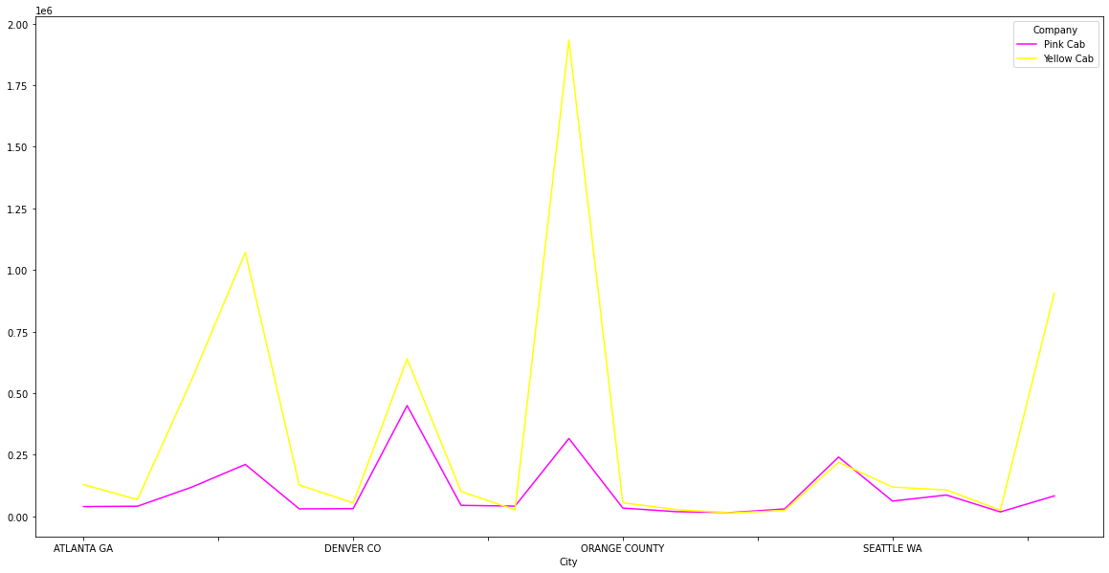
EDA and Summary –Transaction Analysis by Cities
Cities from each zone are selected in which Yellow Cab seems to dominate the market with the most transactions compared to Pink Cab.

Slide 11
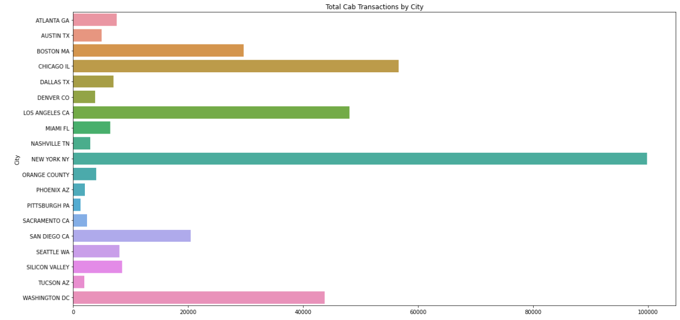
EDA and Summary - Transaction Analysis by City
New York has the highest number of Transactions followed by Chicago, Los Angeles and Washington DC.

Slide 12
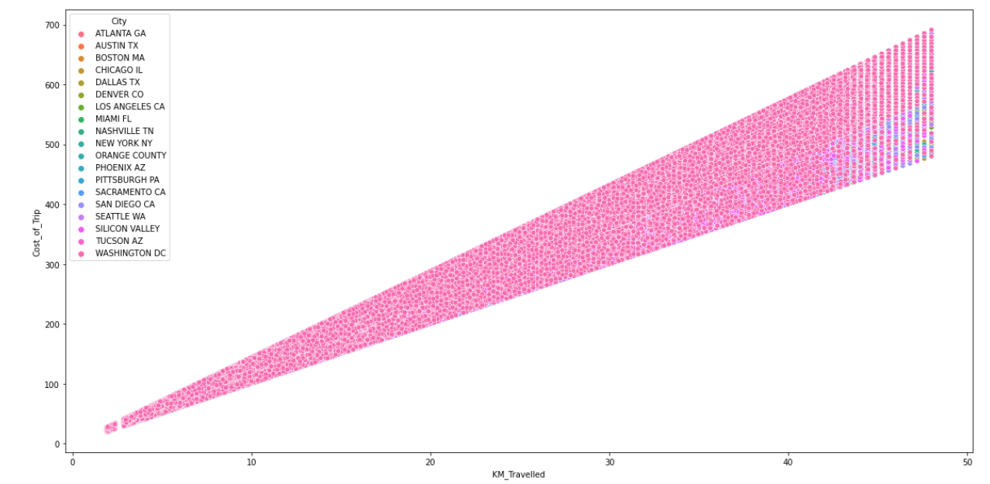
EDA and Summary – Cost of Trip vs KM Travelled
Cost of Trip and KM Travelled are directly proportional but not depending according to city.

Slide 13
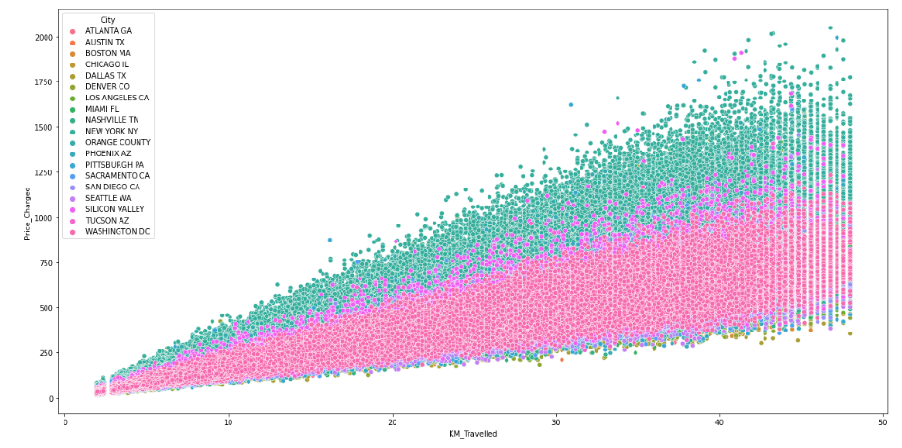
EDA and Summary – Price Charged vs KM Travelled
New York and Silicon Valley cost more in cab fare than other cities.

Slide 14
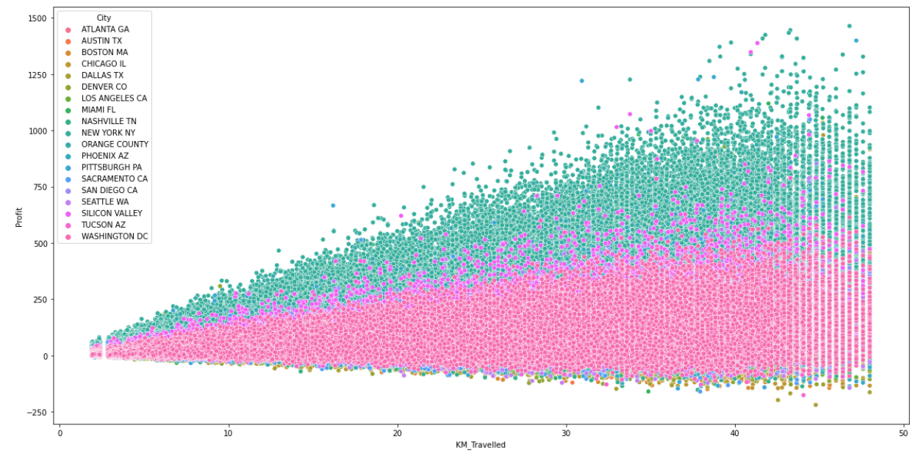
EDA and Summary – City Profit and KM Travelled Analysis
Highest profits are generated in New York City and Silicon Valley.

Slide 15
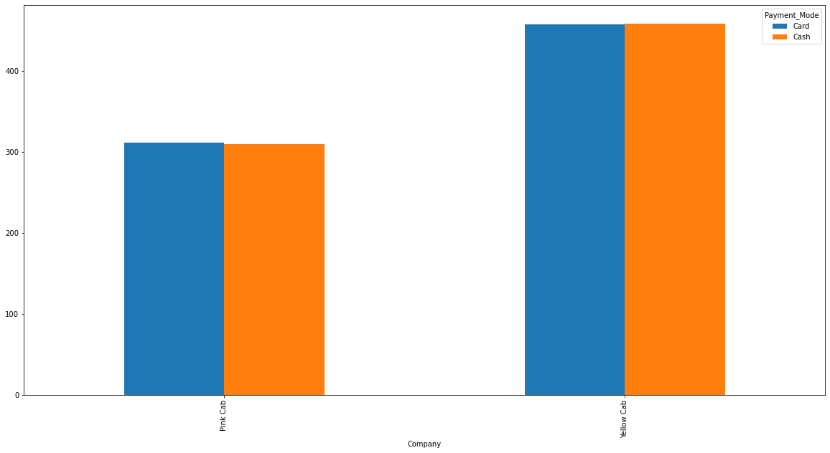
EDA and Summary – Payment Mode Analysis
Yellow cab is observed to receive more payments compared to that of Pink Cab.

Slide 16
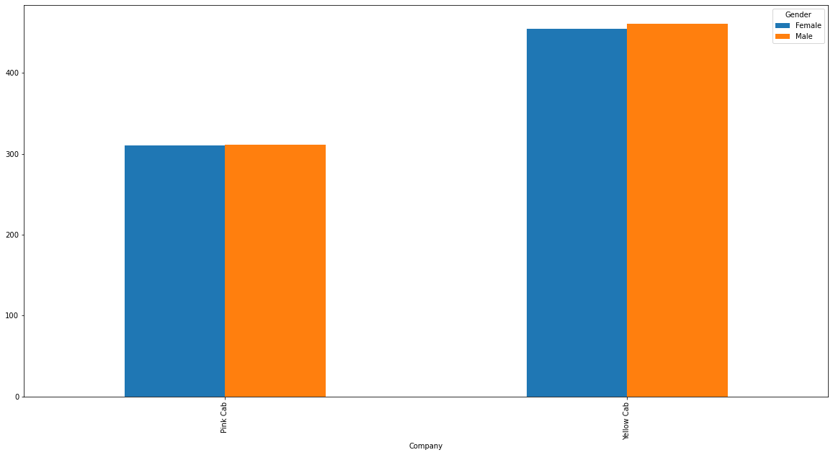
EDA and Summary – Gender Share Analysis
Overall customers use the Yellow cab compared to Pink Cab having the least males and females.

Slide 17
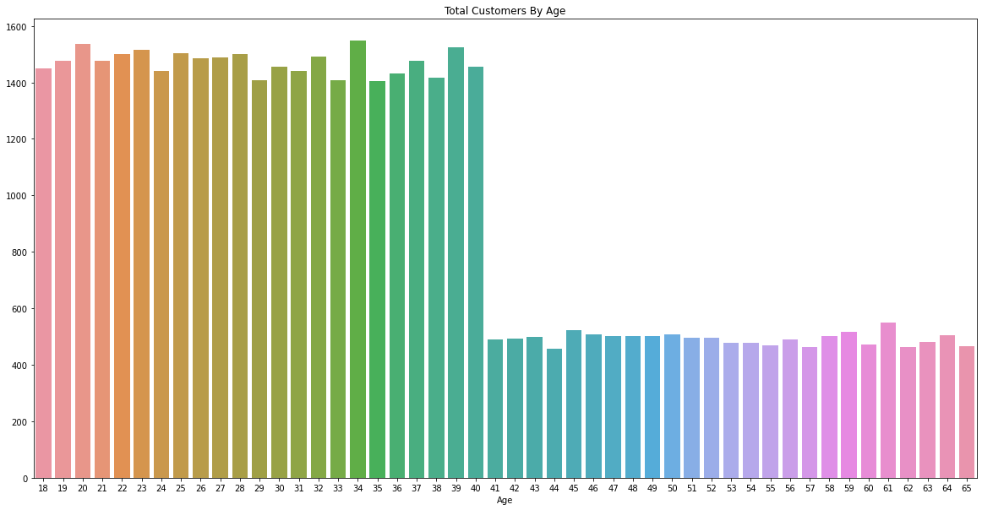
EDA and Summary – Age Analysis (Customers)
The 20-29 and 30-39 age groups dominate in terms of total customers and transactions for both cab companies.

Slide 18
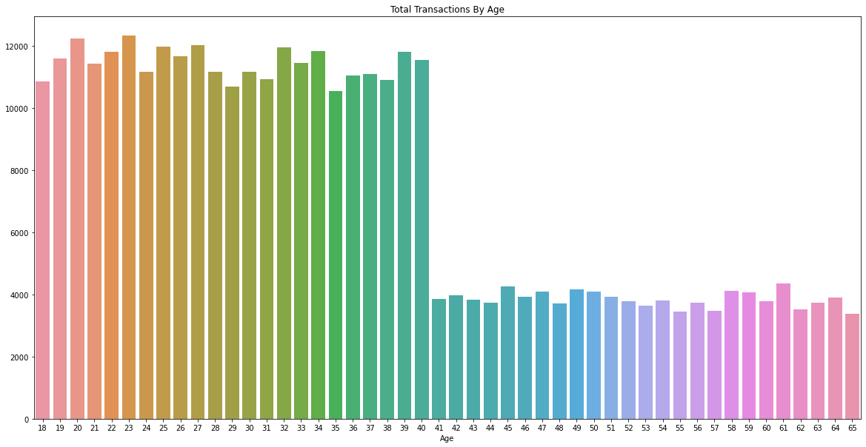
EDA and Summary – Age Analysis (Transactions)
The 20-29 and 30-39 age groups dominate in terms of total customers and transactions for both cab companies.

Slide 19
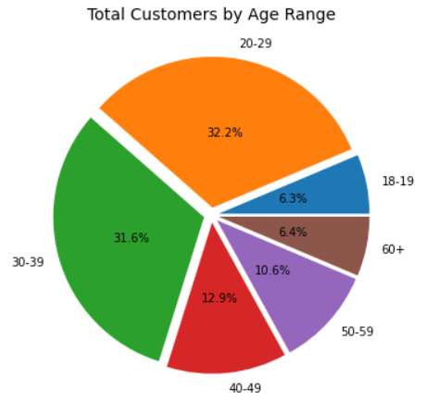
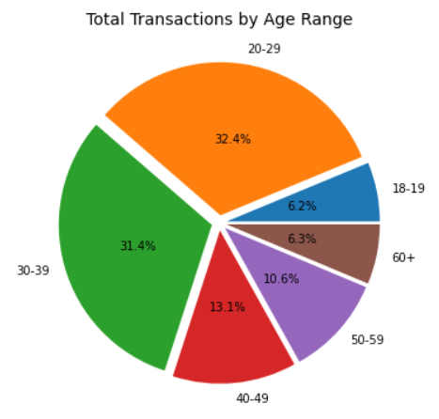
EDA and Summary – Age Analysis
The 20-29 and 30-39 age groups dominate in terms of total customers and transactions for both cab companies.
Age_Range | Total Customers
18-19 | 2,925
20-29 | 14,853
30-39 | 14,598
40-49 | 5,935
50-59 | 4,899
60+ | 2,938
Age_Range | Total Transactions
18-19 | 22,437
20-29 | 116,430
30-39 | 112,735
40-49 | 47,017
50-59 | 38,087
60+ | 22,686

Slide 20
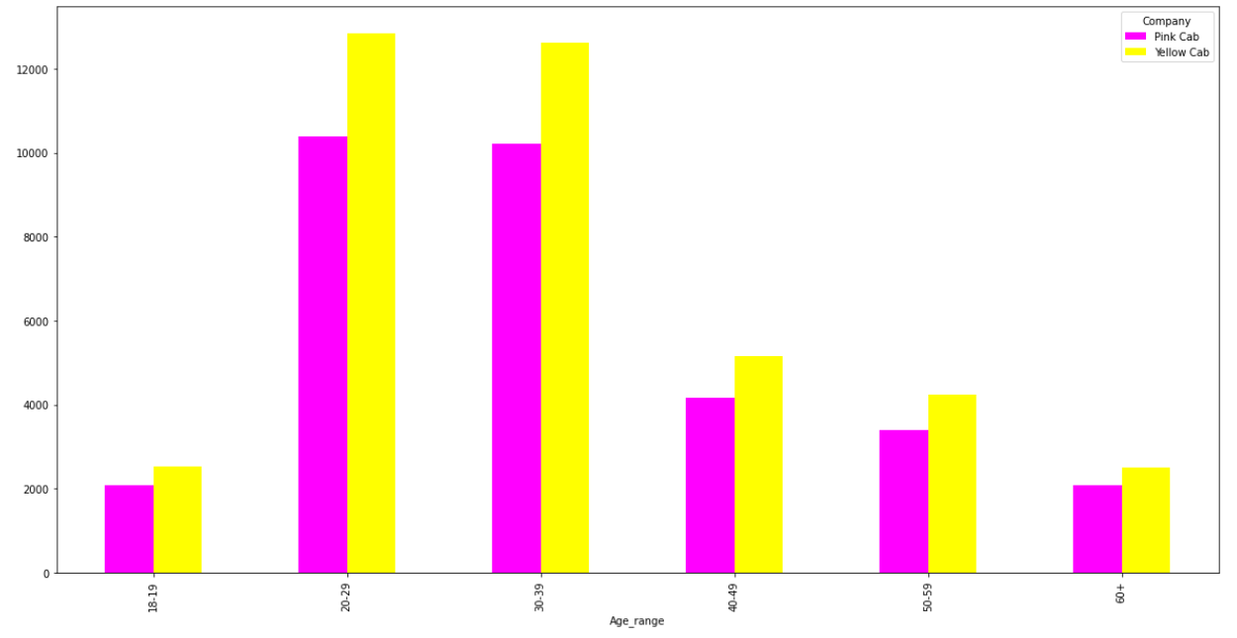
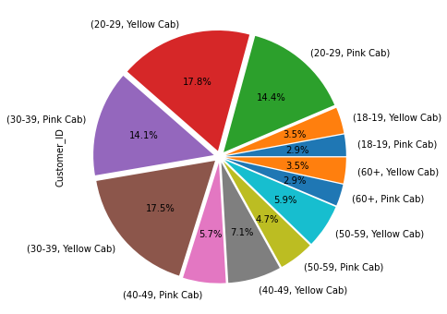
EDA and Summary – Age Analysis
Yellow Cab has a larger customer base for each age group compared to Pink Cab.

Slide 21
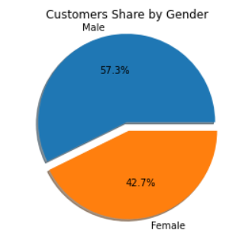
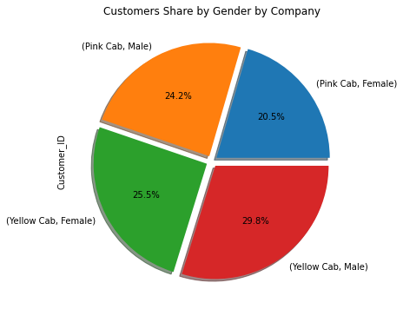
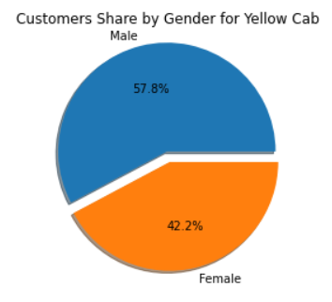
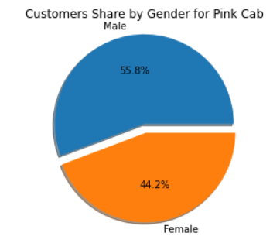
EDA and Summary – Customer Share by Gender Analysis
Overall the male customers use the cab frequently with Yellow Cab having the most males and females.

Slide 22
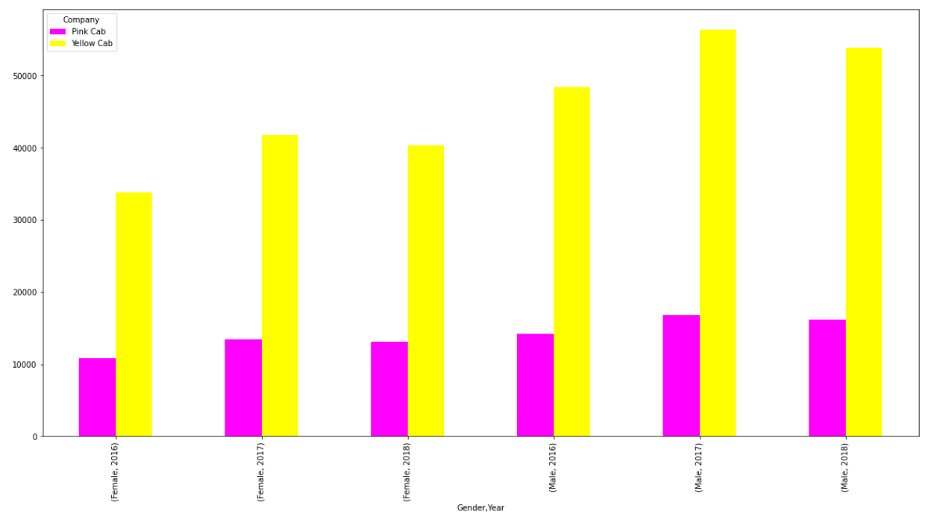
EDA and Summary - Gender and Transaction Analysis
Yellow Cab has the higher number of transactions for both genders in the consecutive years.
Both companies experienced a drop in transaction numbers for both genders in 2018.

Slide 23
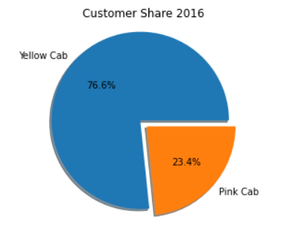
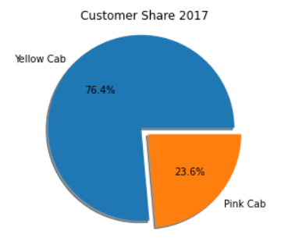
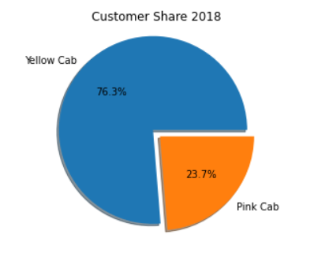
EDA and Summary – Customer Share Market Analysis
Yellow Cab dominates more than half of the customer base for the three years.

Slide 24
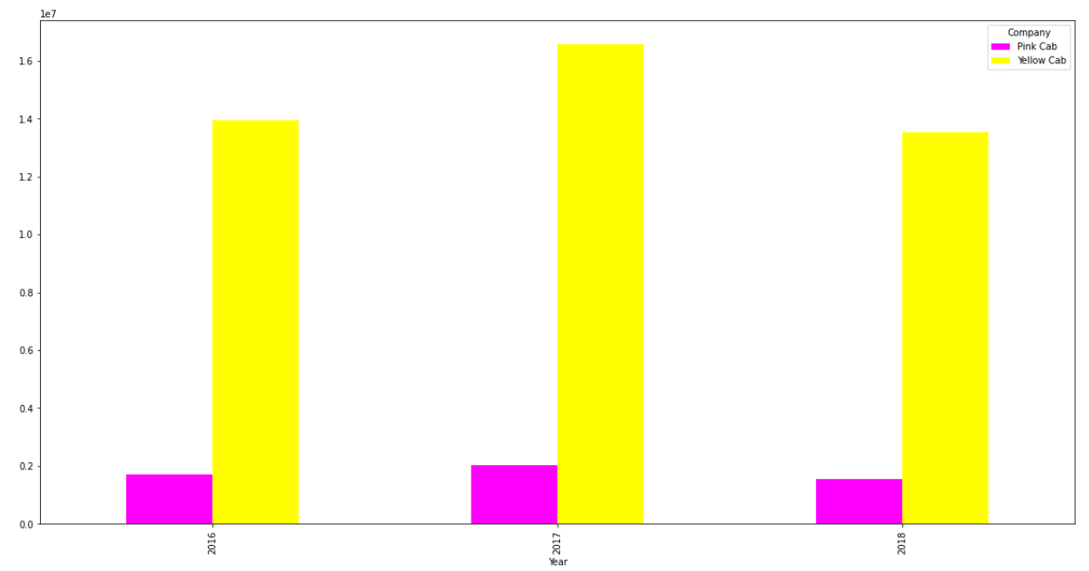
EDA and Summary – Profit Analysis
On a year on year basis Yellow Cab exhibits the highest profits.

Slide 25
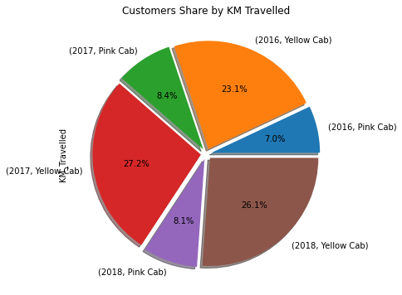
EDA and Summary – Customer Share by Km Analysis
Yellow Cab dominates more than half of the customer base with respect to Km for the three years.

Slide 26
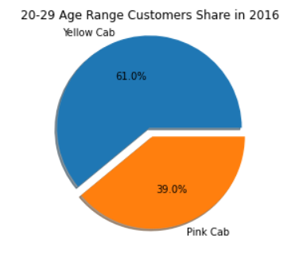
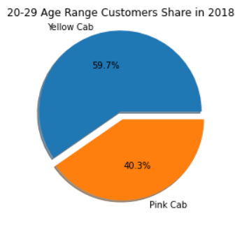
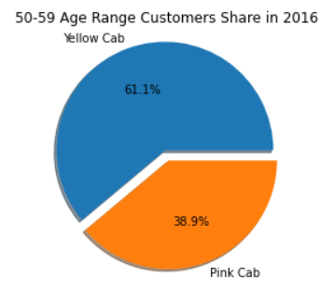
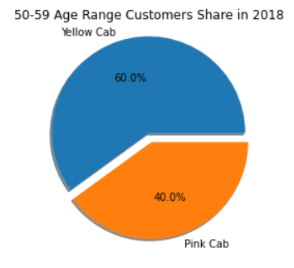
EDA and Summary – Age and Customer Share Relationship
As highlighted for these age groups Yellow Cab dropped in customers share for 2018 compared to 2016.

Slide 27
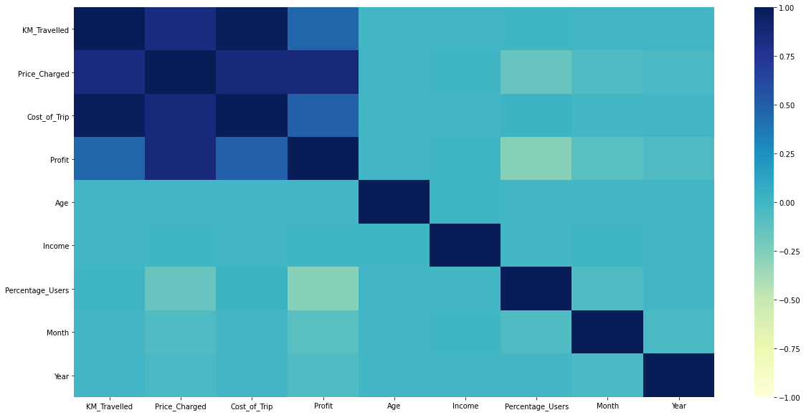
EDA and Summary – Profit Analysis Heatmap

Slide 28
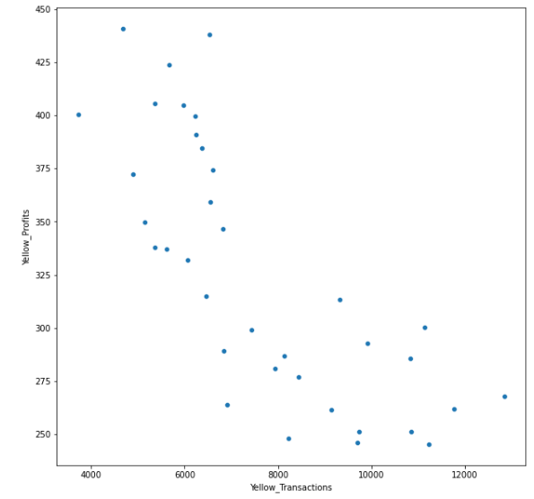
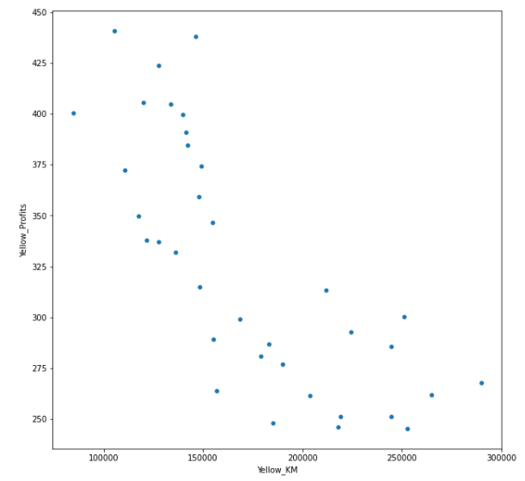
EDA and Summary – Yellow Cab Profit Analysis
Sum of profits, sum of transactions and sum of km travelled have a negative correlation.

Slide 29
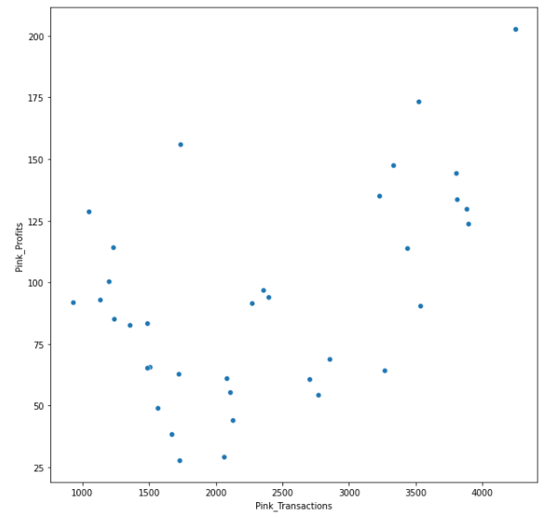
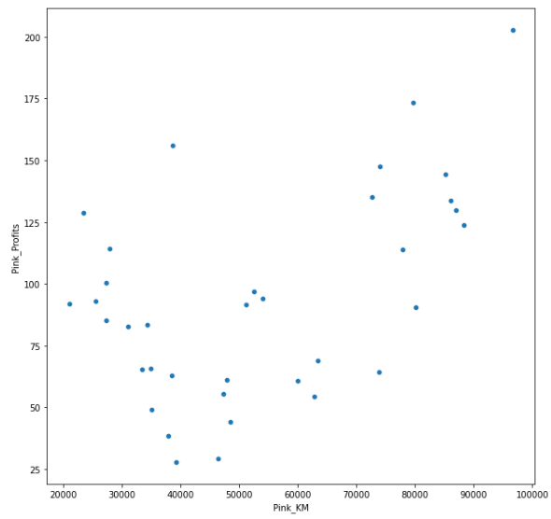
EDA and Summary - Pink Cab Profit Analysis
Sum of profits, sum of transactions and sum of km travelled have a positive correlation.

Slide 30
Hypothesis
One
H0: KMs Travelled and Profit gained are not related. (p = 0)
H1: KMs Travelled and Profit gained are related. (p != 0)
Conclusion: KMs Travelled and Profit gained are related.
Two
H0: There is no difference in KM Travelled by Females compared to Males for Yellow Cab.
H1: There is a difference in KM Travelled by Females compared to Males for Yellow Cab.
Conclusion: There is no difference in KM Travelled by Females compared to Males for Yellow Cab.

Slide 31
Hypothesis
Three
H0: Females bring in less profits than Males for Yellow Cab.
H1: Females bring in more profits than Males for Yellow Cab.
Conclusion: Females bring in more profits than Males for Yellow Cab.
H0: Females bring in less profits than Males for Pink Cab.
H1: Females bring in more profits than Males for Pink Cab.
Conclusion: Females bring in less profits than Males for Pink Cab.
Four
H0: The mean Profit for the different Age groups for Yellow Cab are equal.
H1: One or more of the mean Profits for the different Age groups for Yellow Cab are unequal.
Conclusion: There is a difference in Profit due to Age.
H0: The mean Profit for the different Age groups for Pink Cab are equal.
H1: One or more of the mean Profits for the different Age groups for Pink Cab are unequal.
Conclusion: There is no difference in Profit due to Age.

Slide 32
Hypothesis
Five
H0: There is no difference in Profits for Card and Cash Payers for Yellow Cab.
H1: There is a difference in Profits for Card and Cash Payers for Yellow Cab.
Conclusion : There is no difference in Profits for Card and Cash Payers for Yellow Cab.
H0: There is no difference in Profits for Card and Cash Payers for Pink Cab.
H1: There is a difference in Profits for Card and Cash Payers for Pink Cab.
Conclusion : There is no difference in Profits for Card and Cash Payers for Pink Cab.

Slide 33
Recommendations
After an evaluation of both companies Yellow Cab was found to be better than Pink Cab based on the following points:
Transaction Analysis: Yellow Cab has domination over the market with total transactions processed three times those for Pink Cab over the 3 years.
Customer Share: From 2016 - 2018 Yellow Cab had a customer reach of more than 76% though there was a drop of 0.3% which can be considered insignificant.
Age Wise Reach: For each age group Yellow Cab has larger numbers of customers with both companies having the most customers in the 20 - 29 and 30 - 39 age groups.
Gender Aspect: Yellow Cab has the highest number of transactions for both male and female customers from 2016 – 2018.
Profit Wise: Yellow Cab exhibits profits twelve times those for Pink Cab year on year. Also the more KM are travelled the higher the profits get.
For Yellow Cab there is a difference in profit per age group, which allows for versatility in campaigns that they may launch to increase profits.
Based on the above points, Yellow Cab is the most preferred option for investment
We recommend Yellow Cab for investment.

Slide 34
Thank You

